Slide 1


Assortment Growth: Taxonomy Track
Feb 15, 2012

Slide 2
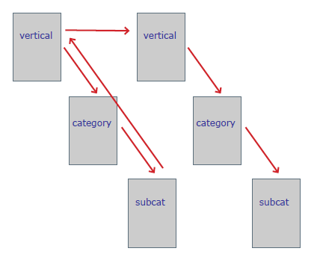
Problem Statement
WCS website hierarchies (Sears.com, Kmart.com, MyGofer.com, etc.) are limited to exactly 3 levels
  Unclickable category groupings in navigation flyouts
  Too many categories within vertical (40 categories in Fitness & Sports; 63 categories in For the Home)
  Too many subcategories required to differentiate product types. Results in long lists of subcategories (difficult to scan), too many products in subcategories for customers to browse through
  Forcing 3 level taxonomy even in those cases where 2 levels would sufficient. Customers have to go through unnecessary extra clicks before seeing products
WCS website hierarchies are driven by internal BU organizations
less by customer needs and behaviors
Linear website hierarchies do not meet
customer needs

Slide 3
The limitation significantly affects online revenue
Softline - Estimated loss of revenue: 25 bps
To further improve sales and enhance marketing efforts, the Apparel team would like to create verticals based on a customer segment (e.g. “For Her,” “For Him”) instead of a category focus (e.g. Clothing, Shoes and Jewelry)
  Because of the 3-level limitation, it is impossible to implement this properly, resulting in missed sales opportunities.
2. Attributes Used as 4th Level - Estimated loss of revenue: 25 bps
Type Attributes are often used in place of a 4th hierarchy level, but are essentially hidden from the user
Even when available, product date for type attributes may be missing, making it impossible for customers to find what they want
3. Marketplace miscategorization – Estimated loss of revenue: 24 bps
These problems will being worsen with our assortment growth plan!!!

Slide 4
Potential Revenue Gain
Soft lines Experience (For Her, For Him) | $ 4M
Marketplace Product Misclassification | $ 1M
Hardline Experience (Auto, Fitness) | $ 2M
DIY Category | $ 0.5M
Total Estimated Revenue Increase | $ 7.5 M

Slide 5
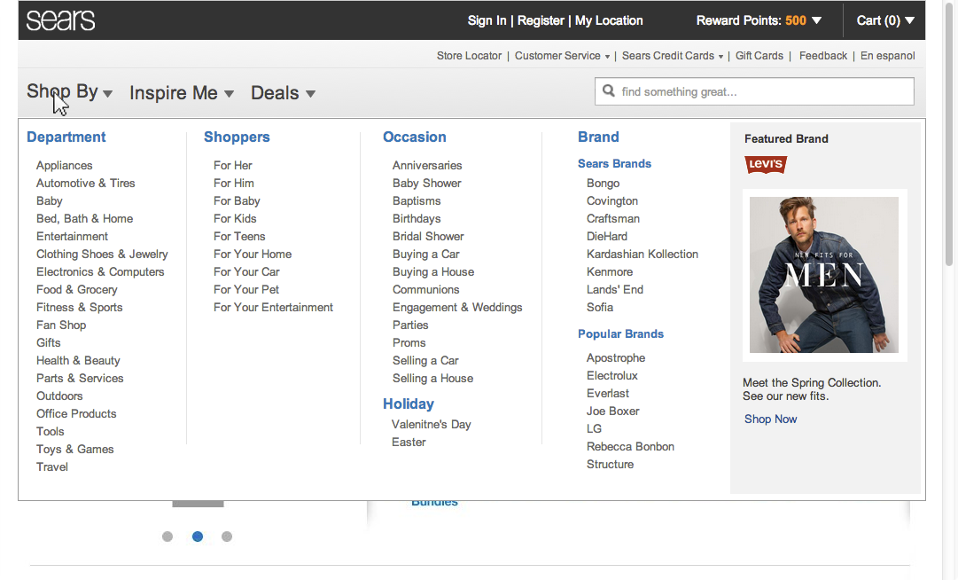
Multiple Shopping Entry Points for Customers

Slide 6
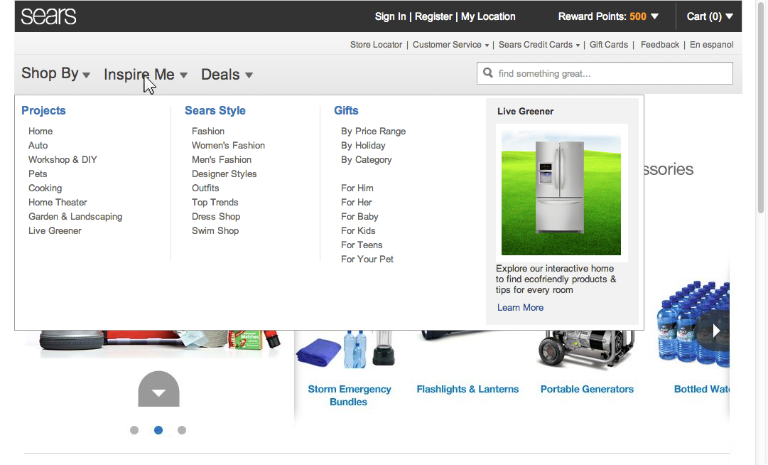
Lifestyle Driven Navigation to Inspire Customers

Slide 7
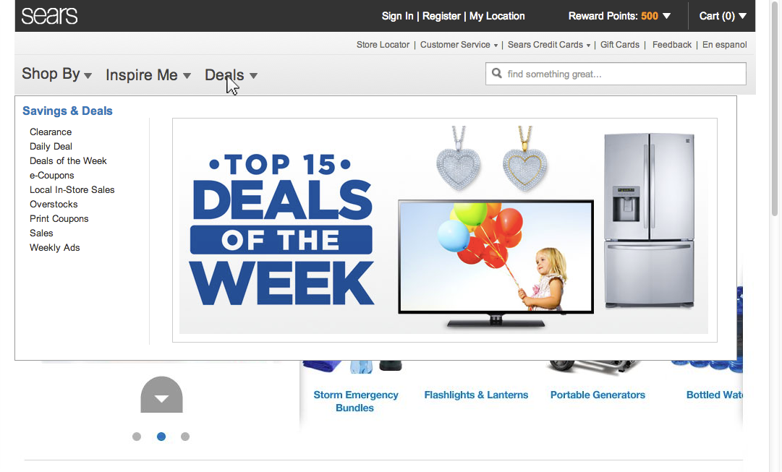
Aggregated View to Deals

Slide 8
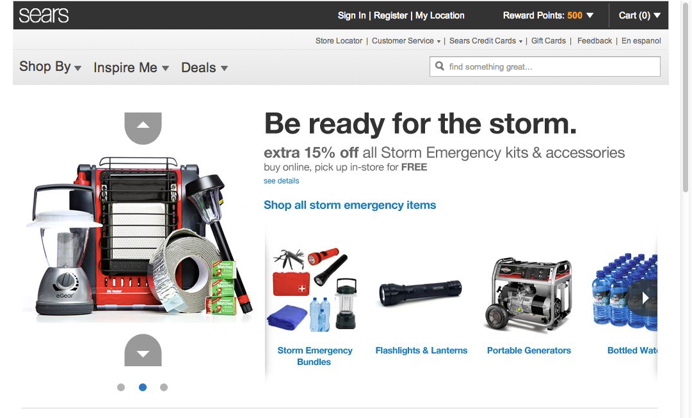
Dynamically Promoting a Subset of Categories

Slide 9
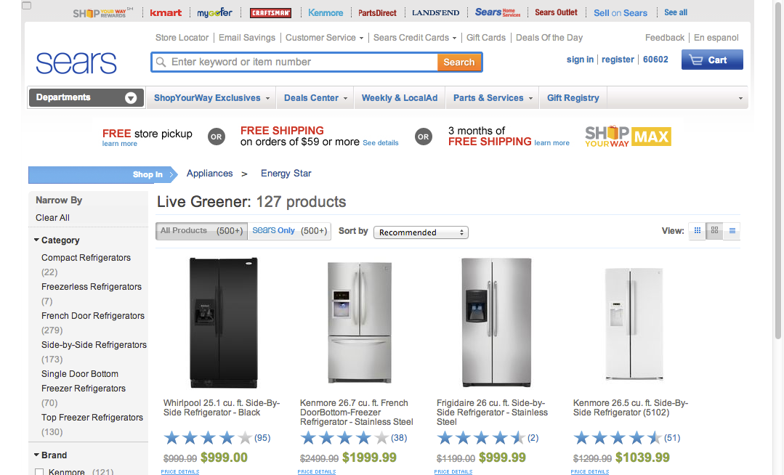
Surfacing Products at any Levels of Taxonomy

Slide 10
Work Streams
Engineering work streams
Projects | Description | Owner | Effort/Target Date
SPIN Enhancement | Ability to independently limit web hierarchies to N levels as well as support unlimited levels “N” should be given for each existing web hierarchy today so we can set the default for each on release night | Pickett, Hahns and Harward, Nathaniel | 1520 hours May, 2013
Browser Configuration | Modify all pages to look for this attribute before rendering a page | Marty Mchugh | 2700 hours
Search Configuration | Modify search configuration for this attributes | Callahan, Michael | Effort estimate due 2/15
Content Enhancement | Consume this attributes in database | Soundarapandian, Dhinakaran | Effort estimate due 2/15
Cart & Check Out | Modify configuration | Jim Huppert | Effort estimate due 2/15
Business work streams
Projects | Description | Owner | Effort/Target Date
New DIY Category | Create a new DIY category to gain more customer visibility to the DIY products | Clint Elmore | June 2013
Taxonomy/UX Development | Develop additional new taxonomy and attributes to support business use cases. Define end user experiences that leverage n-level taxonomy | Annie Wang | May 2013

